Slide 1
User Interface Design
Instructor:

Slide 2
Agenda
Prototype
Screen Flow Diagram
Interaction Flow Modeling Language (IFML)
User Interface Design by Problems

Slide 3
Prototype
Concrete but partial implementation of a system design
To explore usability issues
To refine user requirements
To explore design ideas
Share or co-develop designs with user participants

Slide 4
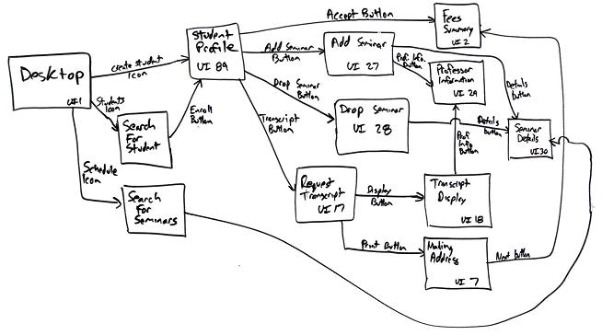
Prototype Screen Flow Diagram (Storyboard)
Screen Flow Diagrams (storyboards, user Interface diagram, interface-flow diagrams, windows navigation diagrams, context-navigation maps) is used to model the high-level relationships between major UI elements and thereby ask fundamental usability questions.
Image: http://www.agilemodeling.com
Notes:
[1] http://www.agilemodeling.com/artifacts/uiFlowDiagram.htm

Slide 5
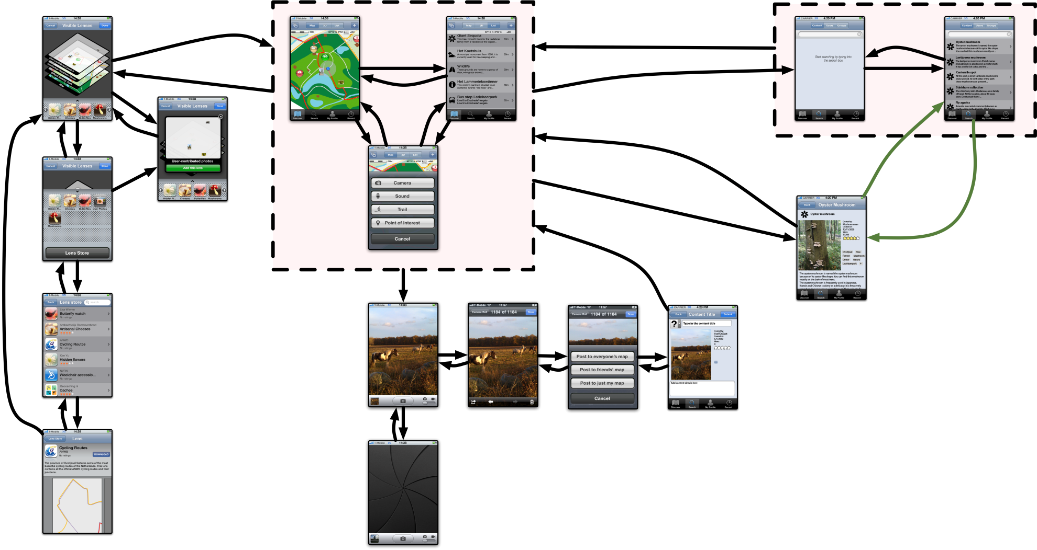
Prototype - Screen Flow Diagram Sketch Screenshot
Image: http://micheljansen.org
Notes:
[1] http://micheljansen.org/projects/discoverijssel/screen-flow-diagram

Slide 6
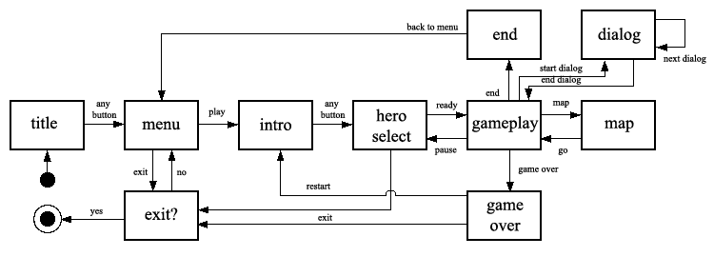
Prototype – Screen Flow Diagram State Machine Diagram
Image: http://emr.deviantart.com
Notes:
[1] http://emr.deviantart.com/art/screen-flow-diagram-174903222

Slide 7
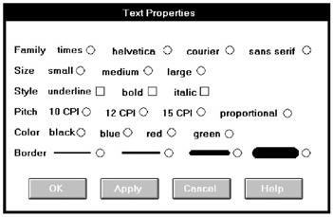
User Interface Design Problem 1

Slide 8
User Interface Design Problem 1 – Analysis 1/2
Captions are not discernible^{[không thấy rõ]} from choice descriptions, and the initial choice descriptions are not left-aligned
The radio buttons and check boxes are not strongly associated with their respective descriptions → certainly causing selection confusion
The horizontal orientation of choices is not efficient for human scanning

Slide 9
User Interface Design Problem 1 – Analysis 2/2
No perception of groupings exists → Hard to use/ Uncomfortable
The ordering scheme of Family, Style, and Color is questionable (Alphabetic ordering would seem to be more appropriate) → Hard to use/ Uncomfortable

Slide 10
User Interface Design Problem 1 - Solution

Slide 11
User Interface Design Problem 1 - Solution Analysis
The title is capitalized to set it off from the remainder of the screen.
The radio buttons and check boxes are arrayed vertically to facilitate scanning and comparison of alternatives
All controls are enclosed in borders to focus the viewer’s attention to them
The screen can be effectively used from left to right or from top to bottom
Family, Style, and Color are alphabetized

Slide 12
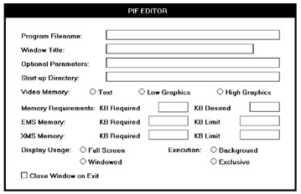
User Interface Design Problem 2

Slide 13
User Interface Design Problem 2 - Analysis
The word “memory” repeated four times in succession seems redundant, indicating the potential for a heading
One radio button field (Video Memory) is arrayed horizontally, the others (Display Usage and Execution) are arrayed vertically → non-unique
The control “Close Window on Exit” seems lost^{[lạc lõng]}

Slide 14
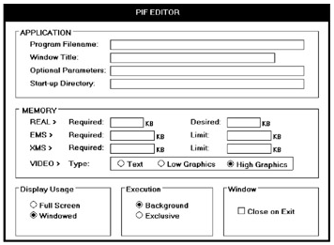
User Interface Design Problem 2 – Solution #1

Slide 15
User Interface Design - Problem 2 Solution #1 Analysis 1/2
The radio buttons/check boxes at the bottom of the screen are arrayed horizontally to provide screen balance
“Close Window on Exit” control field is given an caption to allow a control border consistent with its neighbors and to create screen balance
The Video (Memory) control remains, arrayed horizontally. It would have been desirable to organize its choices vertically, but the best overall fit within the screen is achieved by horizontal orientation

Slide 16
User Interface Design - Problem 2 Solution #1 Analysis 2/2
This redesigned version of the screen is actually 4 percent more complex than the original. The addition of headings and subheadings added to its complexity measure.
Additional information added to a screen to aid understanding can sometimes increase its complexity. So, use the complexity measure as a guide, not as an absolute and final measure of a screen’s effectiveness.

Slide 17
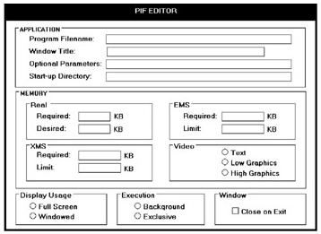
User Interface Design Problem 2 - Solution #2

Slide 18
User Interface Design - Problem 2 Solution #2 Analysis
The Memory section has been restructured to maintain a top-to-bottom flow.
The trade-off is that two columns are now required to present the information

Slide 19
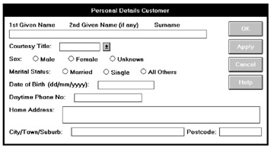
User Interface Design Problem 3

Slide 20
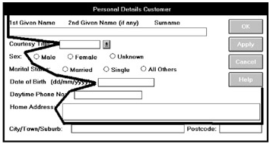
User Interface Design Problem 3 – Analysis 1/2

Slide 21
User Interface Design Problem 3 – Analysis 2/2
There are no groupings
Are the labels above the Name text box intended as captions? Are they intended as prompts? This is not clear.
Is the prompt (dd/mm/yyyy) in the proper location? In its current position, it is set up as an aid to a novice or casual user of the system. For an expert user of the system, who does not need the prompt, it is positioned where it is visual noise. For the expert it should be to the right side of the text box.

Slide 22
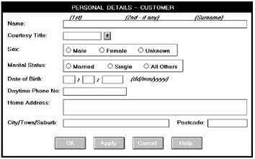
User Interface Design Problem 3 – Solution #1

Slide 23
Problem 3 Solution #1 Analysis 1/2
The Name field is given a caption and a single alignment point is established for both captions and data. Captions and data are now much more readable
Name format instructions (1st, 2nd, and so on) are established as prompts. This prompt designation is signaled by placing them in italics to subdue^{[làm giảm]} them visually.

Slide 24
User Interface Design - Problem 3 Solution #1 Analysis 2/2
The prompt for Date of Birth is placed to the right of its text box, out of the way but still easily viewable. This also permits the alignment point for the text boxes to be moved closer to the captions
Date is also segmented into its component pieces.
The command buttons are positioned at the bottom

Slide 25
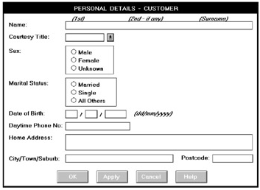
User Interface Design Problem 3 - Solution #2

Slide 26
User Interface Design - Problem 3 Solution #2 Analysis
This screen is identical to the above version except that Sex and Marital Status are arrayed vertically.

Slide 27
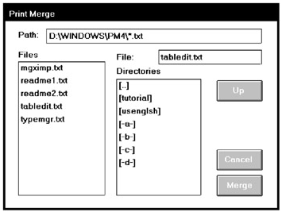
User Interface Design Problem 4

Slide 28
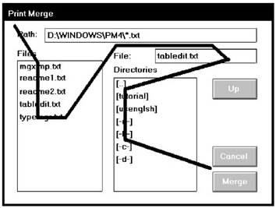
User Interface Design Problem 4 – Analysis 1/2

Slide 29
User Interface Design Problem 4 – Analysis 2/2
The controls on the Print Merge screen are very poorly aligned. The File text box is located quite far from its associated list box
What does the Up button do? It is actually related to the Directories list box. This is certainly not clear.
Look at the required sequence of eye movements through this screen, as illustrated by the line drawn between successive controls. This is very inefficient.

Slide 30
User Interface Design Problem 4 - Solution

Slide 31
User Interface Design Problem 4 - Solution Analysis
Elements are aligned and the File text box is positioned by its related list box.
The Up command is placed “…” (or in the proper contingent[part] relationship to the Directories list box)
The command buttons are moved to the bottom of the screen and Merge is changed to OK for consistency with the other screens.

Slide 32
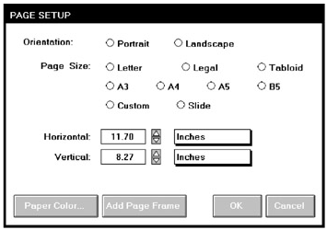
User Interface Design Problem 5

Slide 33
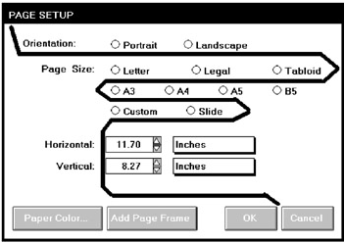
User Interface Design Problem 5 – Analysis 1/3

Slide 34
User Interface Design Problem 5 - Analysis 2/3
The controls on the Page Setup screen are very poorly grouped. Are the nine radio buttons beginning at the Page Size caption one or three groupings?
The horizontal orientation of the radio buttons necessitates a less efficient horizontal scanning and makes visual comparison of the alternatives more difficult.

Slide 35
User Interface Design Problem 5 - Analysis 3/3
Why is the Orientation caption not right-aligned with the other captions?
What are the controls inscribed with Inches?
Nonstandard controls increase learning requirements and add to the complexity of the interface

Slide 36
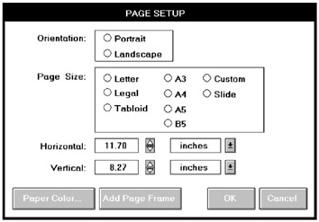
User Interface Design Problem 5 - Solution

Slide 37
User Interface Design Problem 5 - Solution Analysis
The radio buttons are aligned for vertical scanning and placed within borders
The “inches” control is changed to a standard drop-down/pop-up list box.

Slide 38
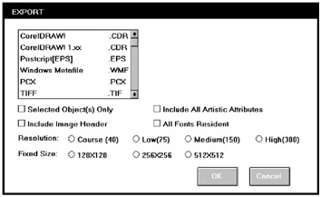
User Interface Design Problem 6

Slide 39
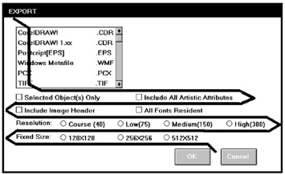
User Interface Design Problem 6 – Analysis 1/2

Slide 40
User Interface Design Problem 6 - Analysis
The check boxes and radio buttons on the Export screen are again very poorly grouped
Can the check boxes be grouped?
The list box has no caption with it.
Screen balance is also poor, with the large open area in the upper-right part of the screen. Again, look at the required eye scan through this screen.

Slide 41
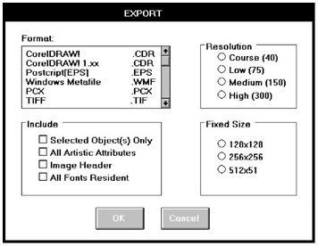
User Interface Design Problem 6 - Solution

Slide 42
User Interface Design Problem 6 - Solution Analysis
The radio buttons and check boxes are aligned for vertical scanning and placed within borders.
The check boxes are given a caption, as is the list box.
For balance purposes, the controls are arrayed in two columns.

Slide 43
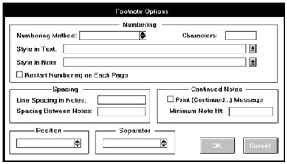
User Interface Design - Problem 7 Self Analyze & Suggest Solution

Slide 44
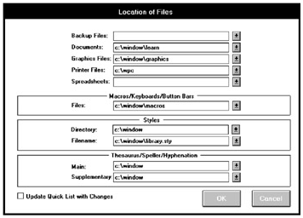
User Interface Design - Problem 8 Self Analyze & Suggest Solution

Slide 45
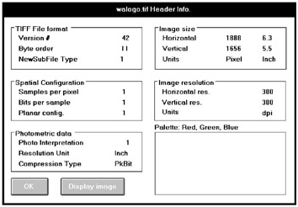
User Interface Design - Problem 9 Self Analyze & Suggest Solution

Slide 46
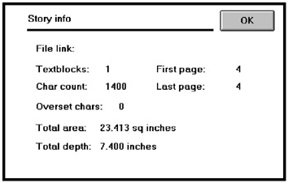
User Interface Design - Problem 10 Self Analyze & Suggest Solution

Slide 47
User Interface Design Screen Design Experience
Alignment: left, right priority
Association
Orientation: vertical, horizontal priority
Grouping
Title order: if we have no require in task ordering then use most nature ordering
Component order: left right, top bottom
Capital, Format
Screen Balance
Standalone check boxes: to get lost

Slide 48


